Slide 1


Brittany Lewandowski
blewandowski@mail.smu.edu
Notes:
Link to YouTube recording: https://youtu.be/vgB4_3Dgcyw
I do not own the rights to this photo. This photo was accessed from the following URL: https://en.wikipedia.org/wiki/Frito-Lay

Slide 2
Today's Discussion
My Approach
Discuss Findings
Provide Recommendations

Slide 3
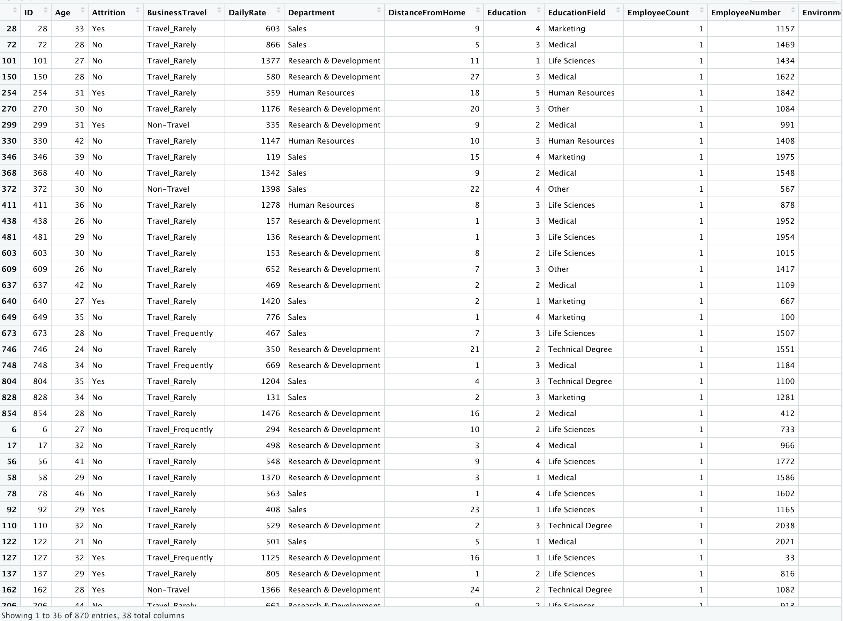
Attrition Data Set

Slide 4
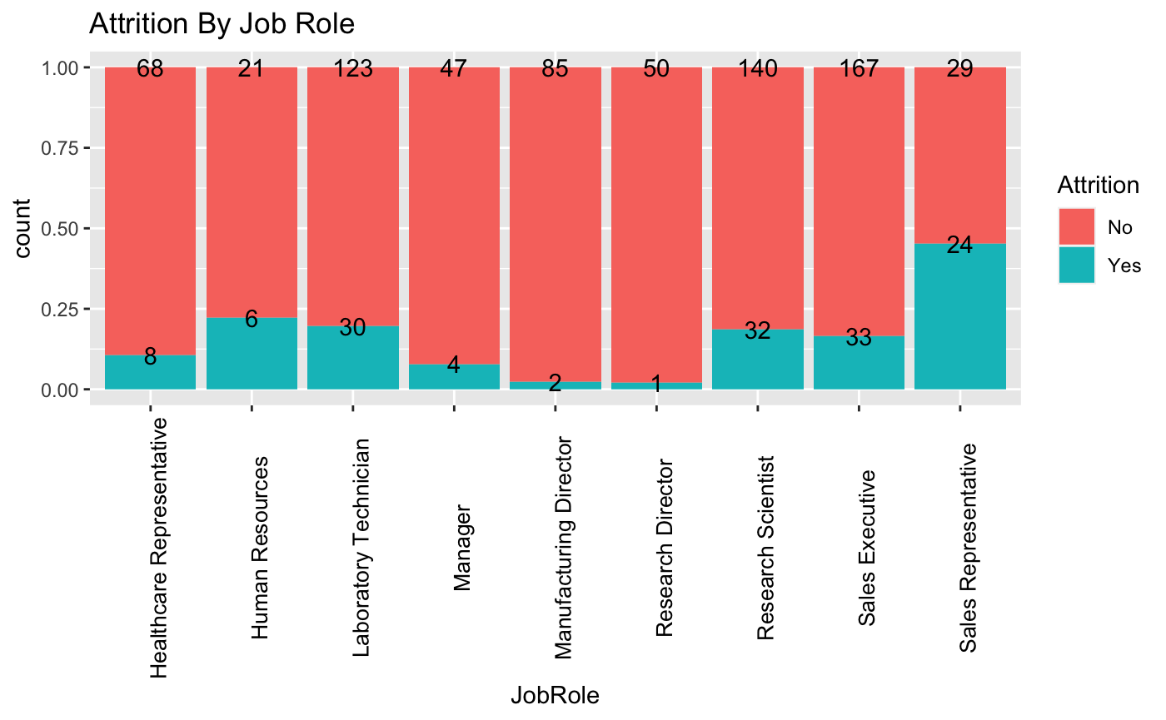
Attrition: Job Role

Slide 5
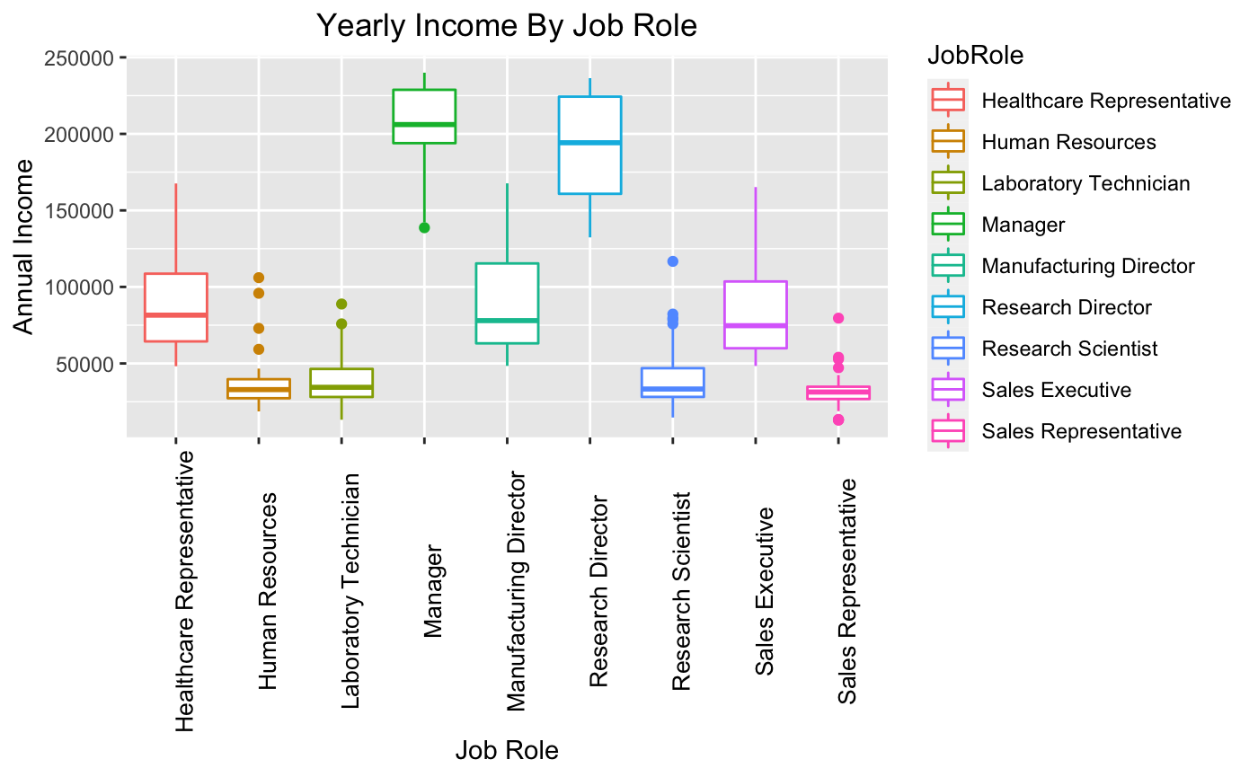
Annual Income: Job Role

Slide 6
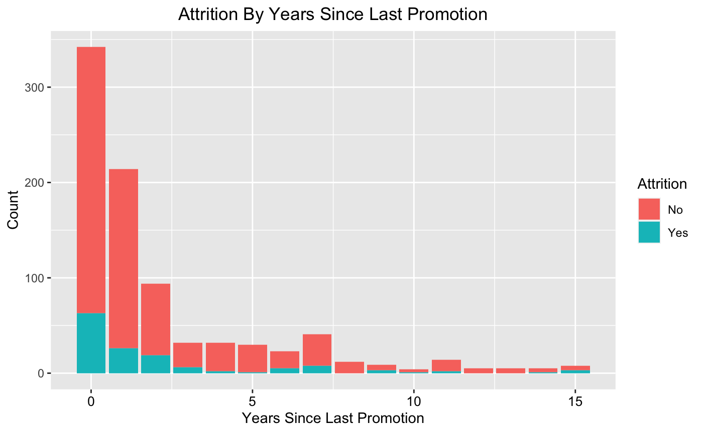
Attrition: Promotion

Slide 7
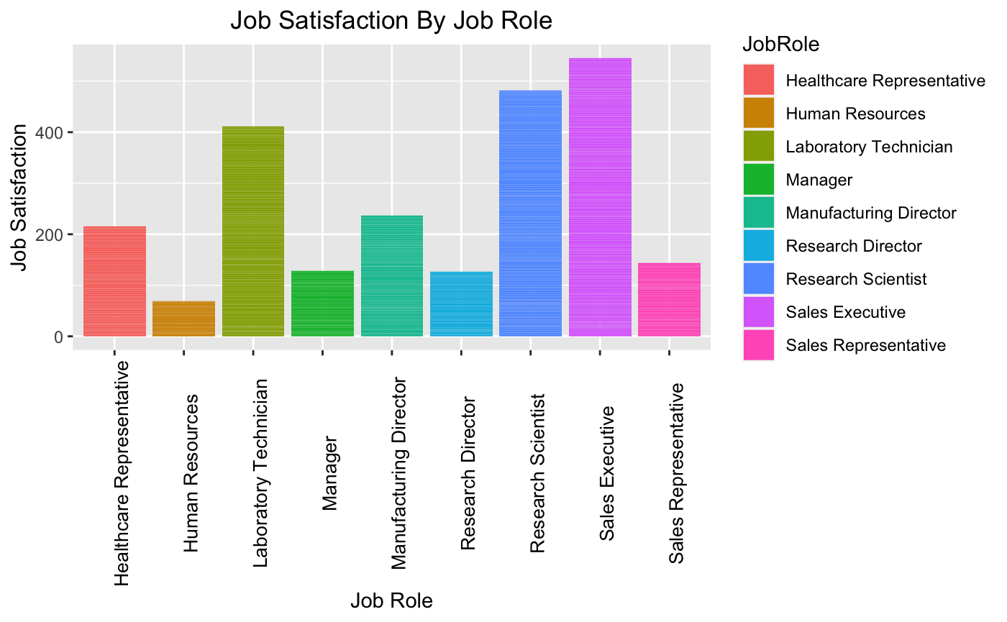
Job Satisfaction

Slide 8

Classifying Attrition
Naïve Bayes Classifier
Years At Company, Job Role, Age
Accuracy of 100%

Slide 9

Predicting Monthly Income
Multiple Linear Regression
Years At Company, Job Role, Age
Adjusted R-Squared: 0.83
RMSE: 1695

Slide 10
Recommendations
Utilize Naïve Bayes Classifier & Multiple Linear Regression Model
Increase Laboratory Technician’s Salary
Avoid Promoting Employees As A Retention Mechanism

Slide 11
Brittany Lewandowski
blewandowski@mail.smu.edu
Notes:
Link to YouTube recording: https://youtu.be/vgB4_3Dgcyw
I do not own the rights to this photo. This photo was accessed from the following URL: https://en.wikipedia.org/wiki/Frito-Lay

